Slide 1


Health Care Sector Data Analytics
P 139 Project From Excelr

Slide 2
Introduction
Project Name: P 139 Dialysis of Patients.
Project Objective:
Improve dialysis station delivery and patient outcomes
Enhance efficiency and effectiveness of dialysis processes
Address specific challenges in the dialysis system.
Project Scope:
Focus on below KPI
Number of Patients across various summaries
Profit Vs Non-Profit Stats
Chain Organizations with respective Total Performance Score as No Score
Dialysis Stations Stats
Category Text - As Expected
Average Payment Reduction Rate
Project Guide- Mr. Shubham Kabre
Mr. Rohit Kumar Mishra
Project Team:
Mr. Sanket Subhash Pawar
Mr. Suhas Suresh Kadam
Mr. Prashik Bhaurao Sorte
Mr. Ajay Vitthalrao Sapate
Mr. Shalom Sandeep Outa
Mr. Thuremella Vikhil
Ms. Priyanka Priyadarshini Pradhan

Slide 3
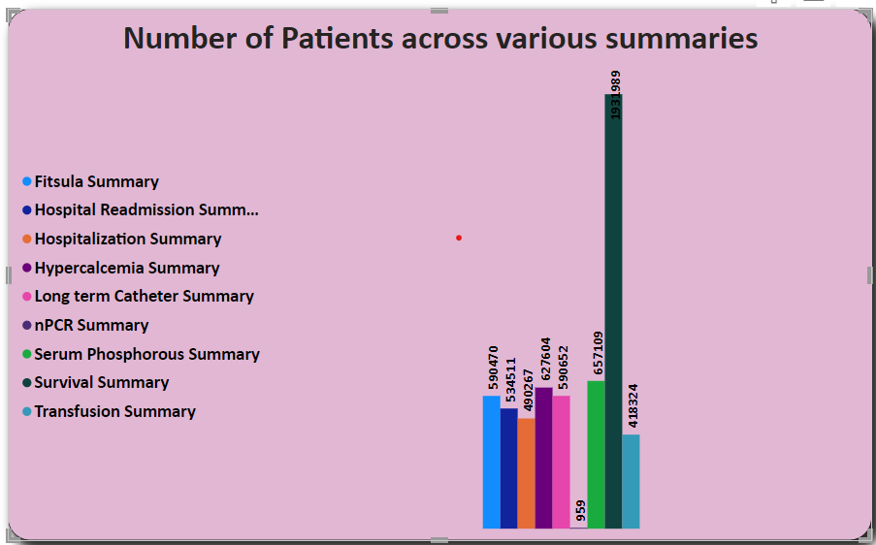
KPI 1 -Number of Patients across various summaries
Introduction: In this presentation, we analyze the patient numbers across various summaries, with a particular focus on the Survival Summary and Phosphorus Summary. By examining the data, we aim to understand the factors contributing to the highest patient volumes in these summaries, providing insights into healthcare delivery and patient needs.
Conclusion : The analysis of patient numbers across summaries reveals that the Survival Summary and Phosphorus Summary have the highest patient volumes. Understanding the factors contributing to this trend can guide healthcare providers in optimizing resources, improving care delivery, and addressing patient needs in these areas. This knowledge enhances patient outcomes and supports effective healthcare management.

Slide 4
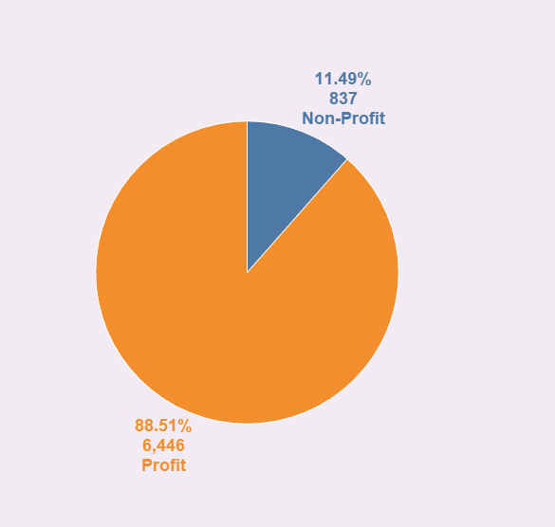
KPI 2 -Profit Vs Non-Profit Stats
Insights:
The analysis reveals that there are 6,446 profit-based dialysis centers and 837 non-profit centers. This suggests a significant difference in the distribution of dialysis facilities based on their profit status.
Conclusion:
The data indicates that the majority of dialysis centers are profit-based, while a smaller number are non-profit. Understanding the differences and implications between these two types of centers can help inform decision-making and resource allocation in the healthcare industry.

Slide 5
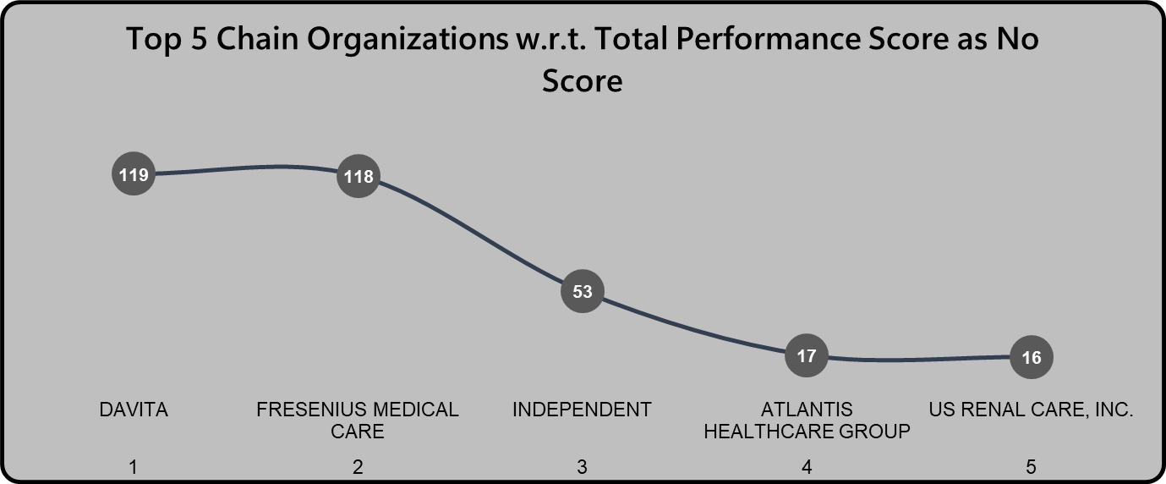

KPI 3 -Chain Organizations w.r.t Total Performance Score as No Score
Insights:
Among the analyzed chain organizations, the top three with no scores for Total Performance are Davita with 119 instances, Fresenius Medical Care with 118 instances, and Independent with 53 instances. These chain organizations have a significant number of cases where no score was assigned to their Total Performance.
Conclusion:
The presence of numerous instances where chain organizations have no score for Total Performance raises concerns regarding the evaluation and reporting of their performance. Further investigation is needed to understand the reasons behind the lack of scores and to identify potential areas for improvement in performance measurement and reporting within these chain organizations.

Slide 6
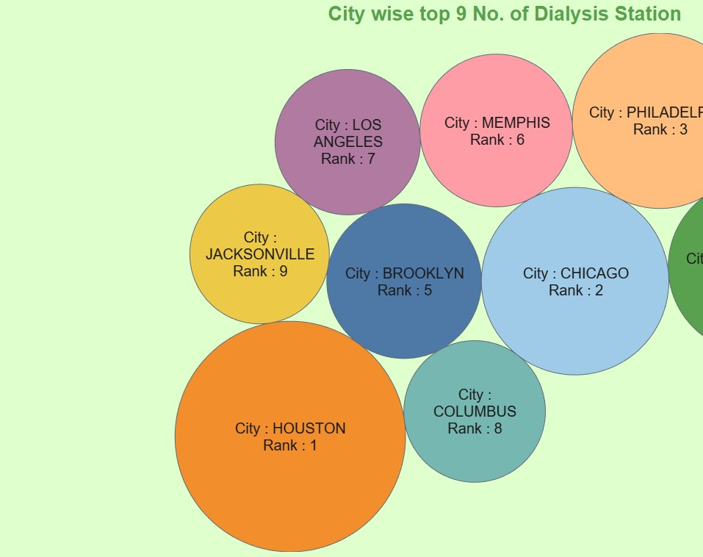
KPI 4 - City-wise Top 10 Number of Dialysis Stations
Insights:
Based on the analysis, the city-wise distribution of dialysis stations reveals Houston as the top-ranking city with 1,911 dialysis stations. Chicago secures the second position with 1,263 stations, followed by Philadelphia in third place with 1,106 stations.

Slide 7
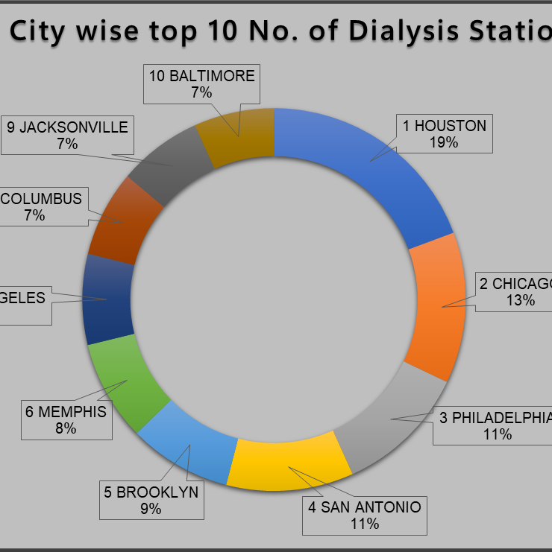
KPI 4 - City-wise Top 10 Number of Dialysis Stations
Conclusion:
The data indicates that Houston, Chicago, and Philadelphia have a significant number of dialysis stations, suggesting a high demand for dialysis services in these cities. Understanding the distribution of dialysis stations can aid in resource allocation and identifying areas where additional infrastructure may be required to meet the needs of the population.

Slide 8
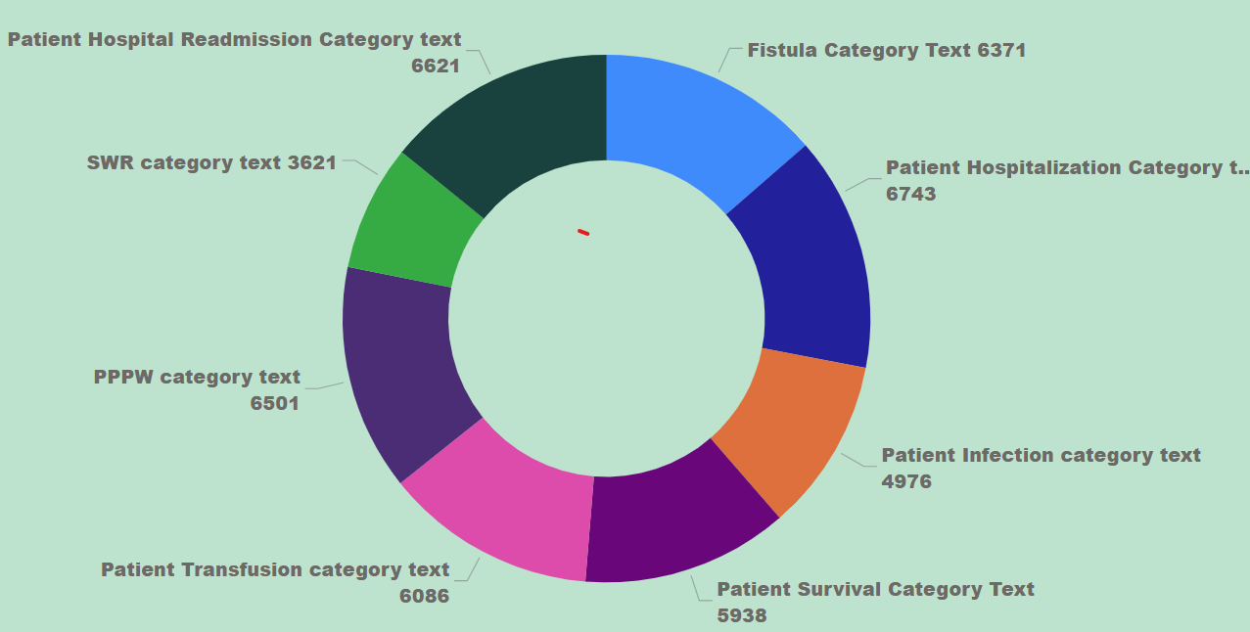

KPI 5 - Number of Category Text - As Expected
Insight: The analysis examines the number of category texts and identifies the top three categories with the highest values as expected. These categories include Fistula Category Text with 6,371 occurrences, Patient Hospital Readmission Category with 6,621 occurrences, and Patient Hospitalization Category Text with 6,743 occurrences.

Slide 9
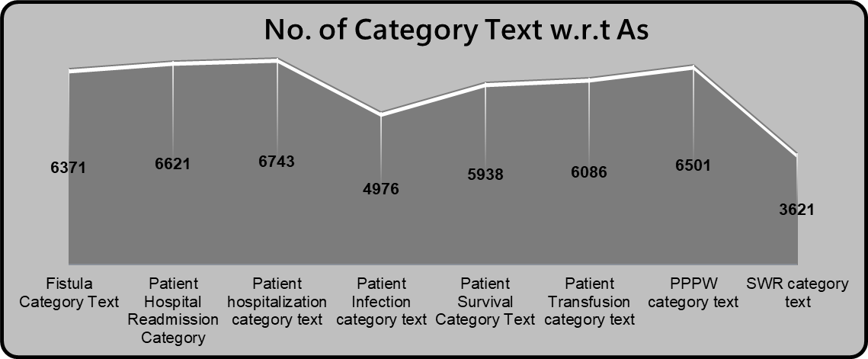

KPI 5 - Number of Category Text - As Expected
Conclusion: The high occurrence of Fistula, Patient Hospital Readmission, and Patient Hospitalization categories suggests that these areas are of significant concern and require attention. Further investigation and targeted interventions may be needed to address the challenges associated with these categories and improve patient outcomes.

Slide 10
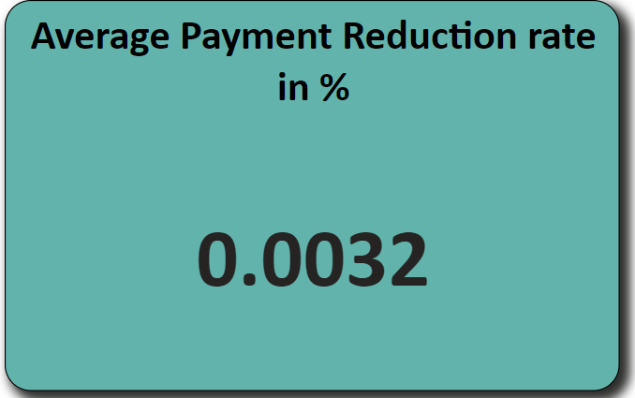

KPI 6 –Average Payment Reduction rate
Insight: The analysis calculates the average payment reduction rate, which is found to be 0.0032%. This rate represents the average decrease in payments for dialysis services.
Conclusion: The average payment reduction rate of 0.0032% indicates a relatively small decrease in payments for dialysis services. While this reduction rate may seem minimal, it is still important to monitor and analyze payment trends to ensure the financial sustainability of dialysis facilities and the accessibility of quality care for patients.

Slide 11
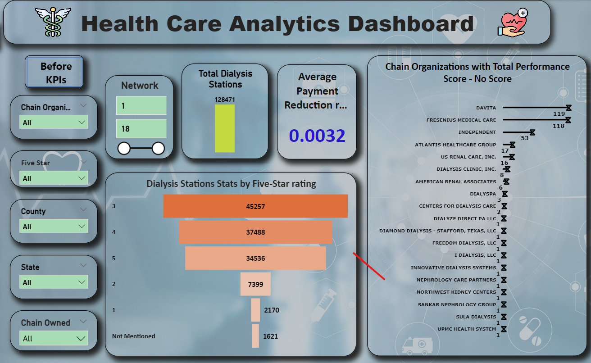

Slide 12


Conclusion And Benefits
1.Number of Patients: The analysis revealed a diverse patient population, allowing for tailored healthcare services to address specific needs and demographics.
Benefits:
1.Enhanced patient care and satisfaction
2.Improved healthcare outcomes
3.Increased operational efficiency
4.Cost savings and resource optimization
2.Profit Vs Non-Profit Stats: Comparing profit and non-profit organizations highlighted the importance of sustainable business models in delivering high-quality dialysis services.
3.Chain Organizations: The evaluation of chain organizations based on total performance scores emphasized the need for continuous improvement strategies to enhance overall performance.
4.Dialysis Stations: The city-wise distribution of dialysis stations showcased variations in healthcare infrastructure and the importance of equitable access to services.
5.Number of Category Text - As Expected: Identifying categories with higher occurrences provided insights into priority areas for intervention and improvement in patient care.
6.Average Payment Reduction Rate: The analysis of payment reduction rates emphasized the need for financial sustainability to ensure continued accessibility and quality of dialysis services.

Slide 13

Thank You.
Thank you for your time and attention.
We appreciate the opportunity to present our data analysis findings.
For any questions or further discussion, please feel free to reach out to us.
We value your feedback and suggestions.

